Slide 1
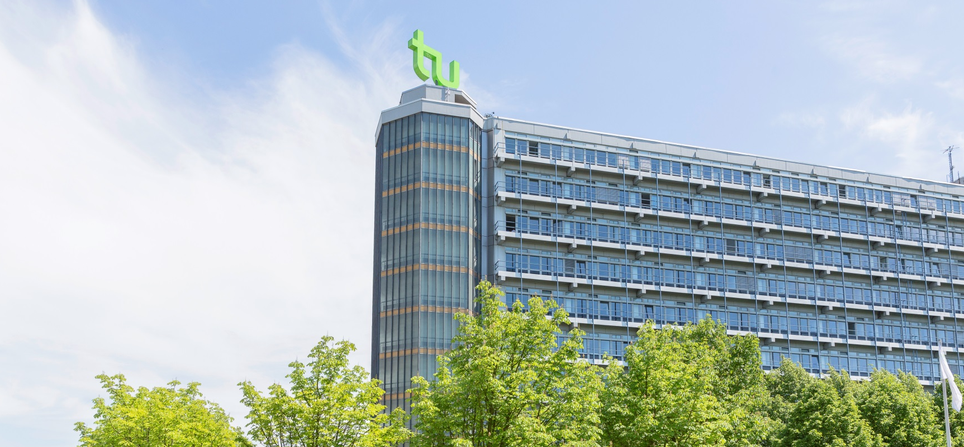
Photo credits: Roland Baege
TU Dortmund University
www.international.tu-dortmund.de/en

Slide 2
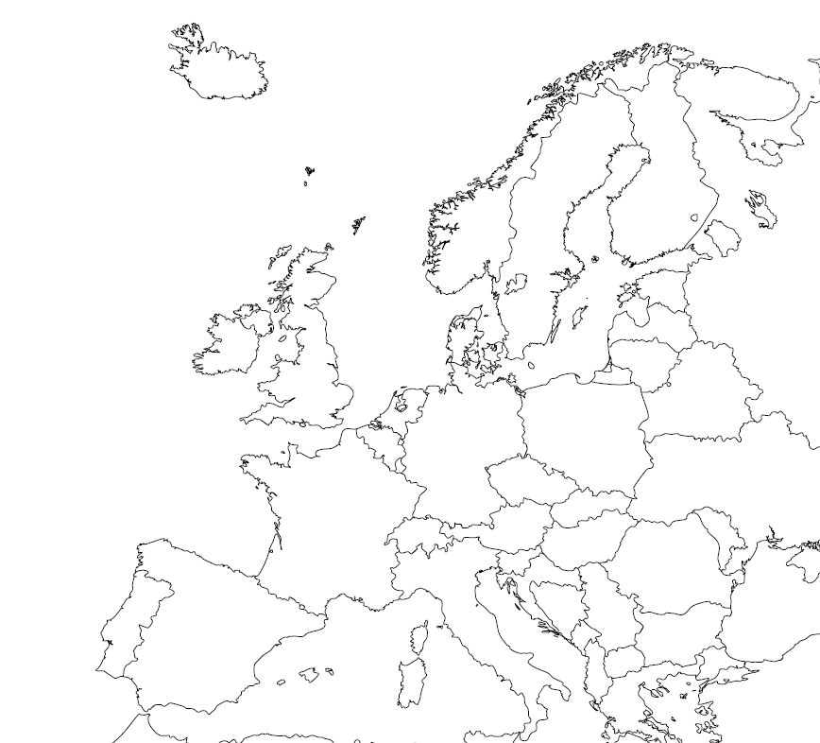
The Ruhr Area is Germany’s most densely populated area with almost 6 million people from over 150 nations
Benefits: safe environment, multicultural, relatively cheap cost of living, great location in Europe
Dortmund has nearly 600,000 inhabitants and a vibrant history
Dortmund

Slide 3
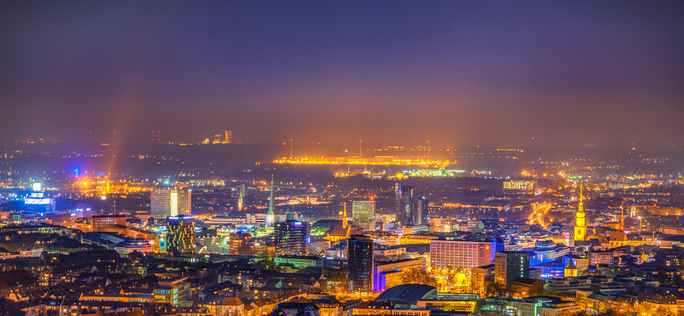
Photo credits: Michele Bergermann
Who are we?
We are Dortmund!

Slide 4
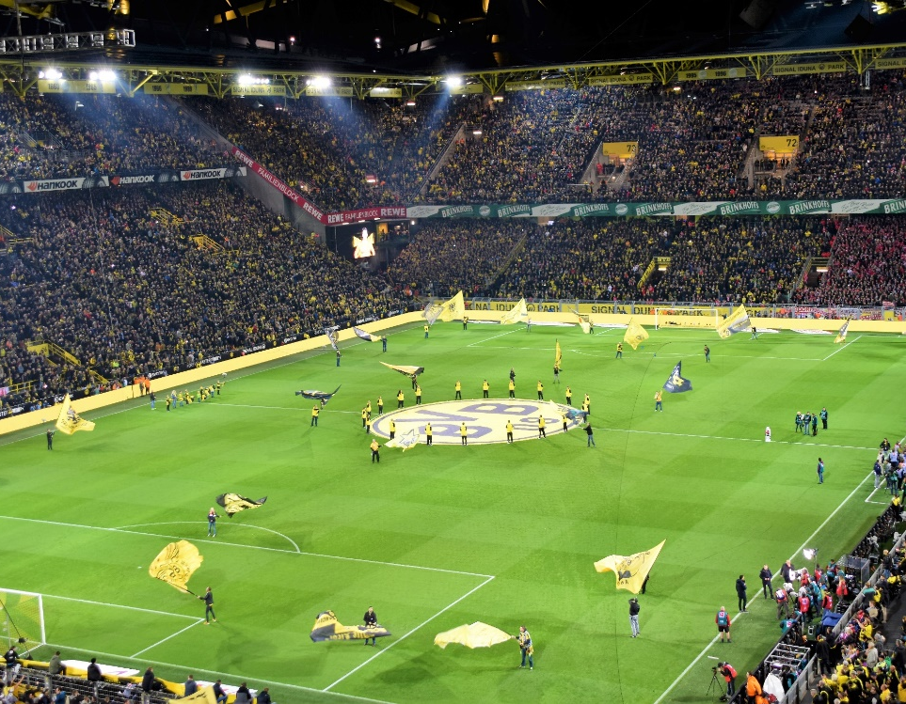
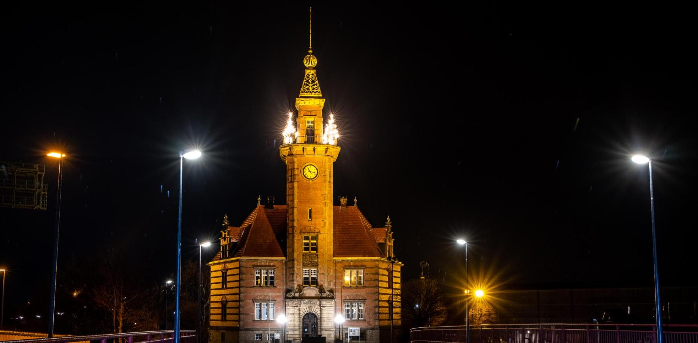
Photo credits: 30daysreplay Germany
Photo credits: Waldemar Brandt
Photo credits: Jonas von Werne
All of this is Dortmund
…and so much more!
Photo credits: Magnus Terhorst
Photo credits: Julian Guttzeit
Photo credits: Evgeni Tcherkasski

Slide 5
Photo credits: Jürgen Huhn
Founded in 1968
Now: approx. 34,000 students, 11% international
2 campuses: Connected by the world’s first fully automatic monorail
Adjacent technology park: the largest in Germany
University Alliance Ruhr: Opportunity to cross-enroll in classes at Ruhr University Bochum and/or at the University of Duisburg-Essen
We are TU Dortmund University with 17 Departments…
Mathematics
Physics
Chemistry & Chemical Biology
Computer Science
Statistics
Biochemical and Chemical Engineering
Mechanical Engineering
Electrical Engineering and Information Technology
Spatial Planning
Architecture and Civil Engineering
Business and Economics
Educational Sciences & Psychology
Rehabilitation Sciences
Humanities & Theology
Cultural Studies
Arts and Sports Sciences
Social Sciences

Slide 6
Photo credits: Silke Viol
Our Services
Comprehensive Orientation and Tutoring Programs
We take care of all logistics: dorm reservation, visa application appointment in Dortmund, etc.
Pick-up at Dortmund train station or on campus upon arrival
Buddy Programs: “Dortmund Doubles” paired with each exchange student
Academic Advisors for each student
Different events
Pre-semester German Intensive Course
March or September, 4 weeks
No tuition fees for exchange students
NRW Ticket
Enables students to use public transport all over North Rhine Westphalia: visit Cologne, Düsseldorf, Münster etc.

Slide 7
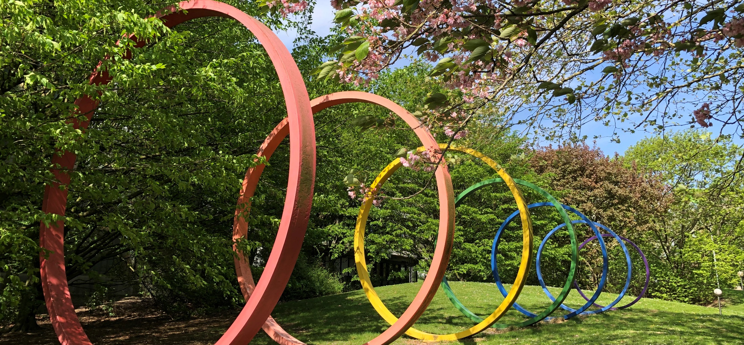
Photo credits: Lea Schubert
New Website in German & English!
All relevant information can be found online (and much more!)
https://international.tu-dortmund.de/en/exchange-students

Slide 8
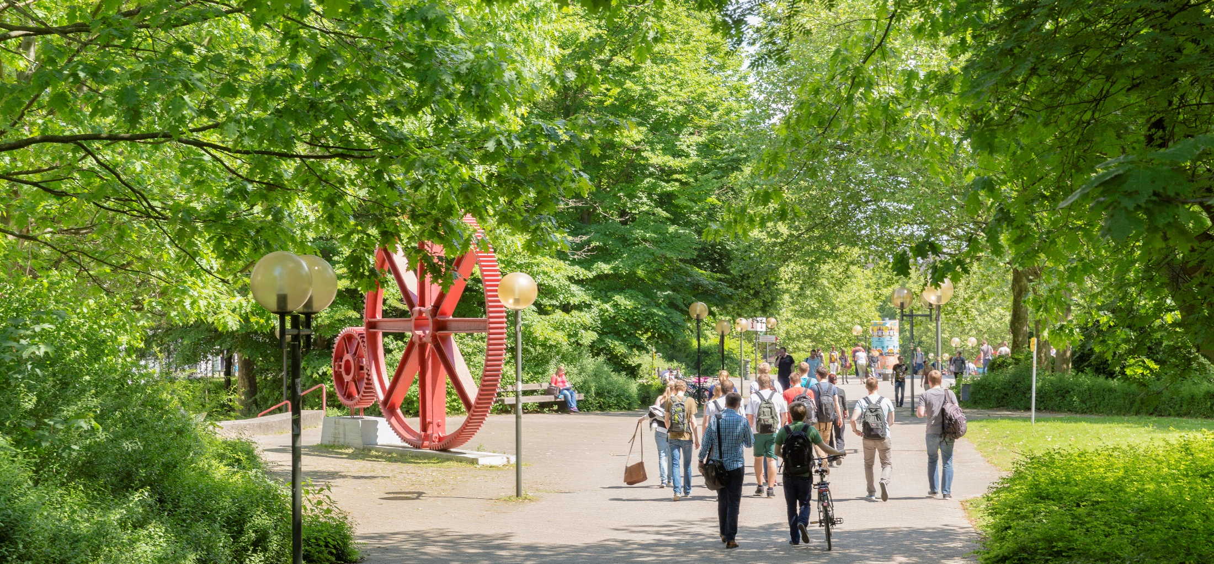
Photo credits: Roland Baege
Be active on & off campus!
Join our university sports!
Over 75 differents sports and a fitness studio on campus
Choirs, big bands, orchestras - the musical life at TU is colorful
Get involved in our ensembles
TU Culture & fun in the city of Dortmund
Visit our downtown campus on the uni­ver­si­ty floor of the “Dort­mun­der U” Center for Arts and Creativity
Get free tickets for performances at the “Theater Dortmund”
Join many events in Dortmund and get tickets for a local soccer game of the BVB!
8

Slide 9
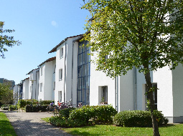
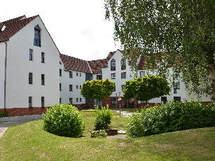
Photo credits: Studierendenwerk Dortmund
Living on campus & in Dortmund
Summer/Spring Semester: April - July Winter/Fall Semester: October - February (German Intensive Course March or September)
The university has its own subway stop approx. six minutes from downtown Dortmund
Student dorms on and off campus
Typically single rooms
Approx. 450 € / month
TU Dortmund University offers several cafés and student cafeterias Expenses for food: approx. 300 € / month
Subsidized meals in the cafeteria (lunch) from
1.50 - 4 € (entrée and sides), including vegan and vegetarian options, a grill counter, salad buffet and an à la carte warm/cold buffet
Bistros are open for breakfast and lunch
“food fakultät” is open for fresh pizza and pasta for lunch or dinner
9

Slide 10
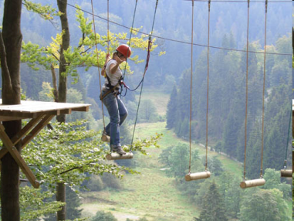
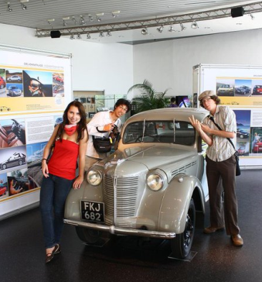
International Summer Program (ISP)
Two-month program (June/July)
ISP students take regular courses in English with German students at TU Dortmund University
Application deadline: 15 February
3 Tracks
1. Engineering Applied Mathematics, Automation and Robotics, Biochemical and Chemical Engineering, Business & Economics, Mechanical Engineering
2. German and European Studies Classes deal with German culture in European and global contexts. For students interested in exploring new developments in German culture from different perspectives
3. Entrepreneurship
In all tracks:
Option for Independent Study/Research, Mandatory German language class, Excursions
Photo credits: International Office/TU Dortmund University
10

Slide 11
International Teaching Internship
Full-time English-language teaching internship
All subjects, Credit available
Grades K-12
Requirements excellent English language. German optional. Open to Education majors and other majors wanting to work with youth/children.
Duration Ideally 2-3 months for Secondary Years, longer for Early/Primary Years. (4 weeks to 6 months possible). Participation in 4-week Pre-Semester German Intensive Course (September or March) possible.
Apply Through the regular exchange application.
Photo credits: Element 5Digital
11

Slide 12
We look forward to welcoming you
in Dortmund soon!
Photo credits: Roland Gorecki/Stadt Dortmund
e-mail: exchange-students@tu-dortmund.de
12

